Slide 1

Onboarding as a New Member
24th July 2024
Notes:
1
5/8-9/2012

Slide 2
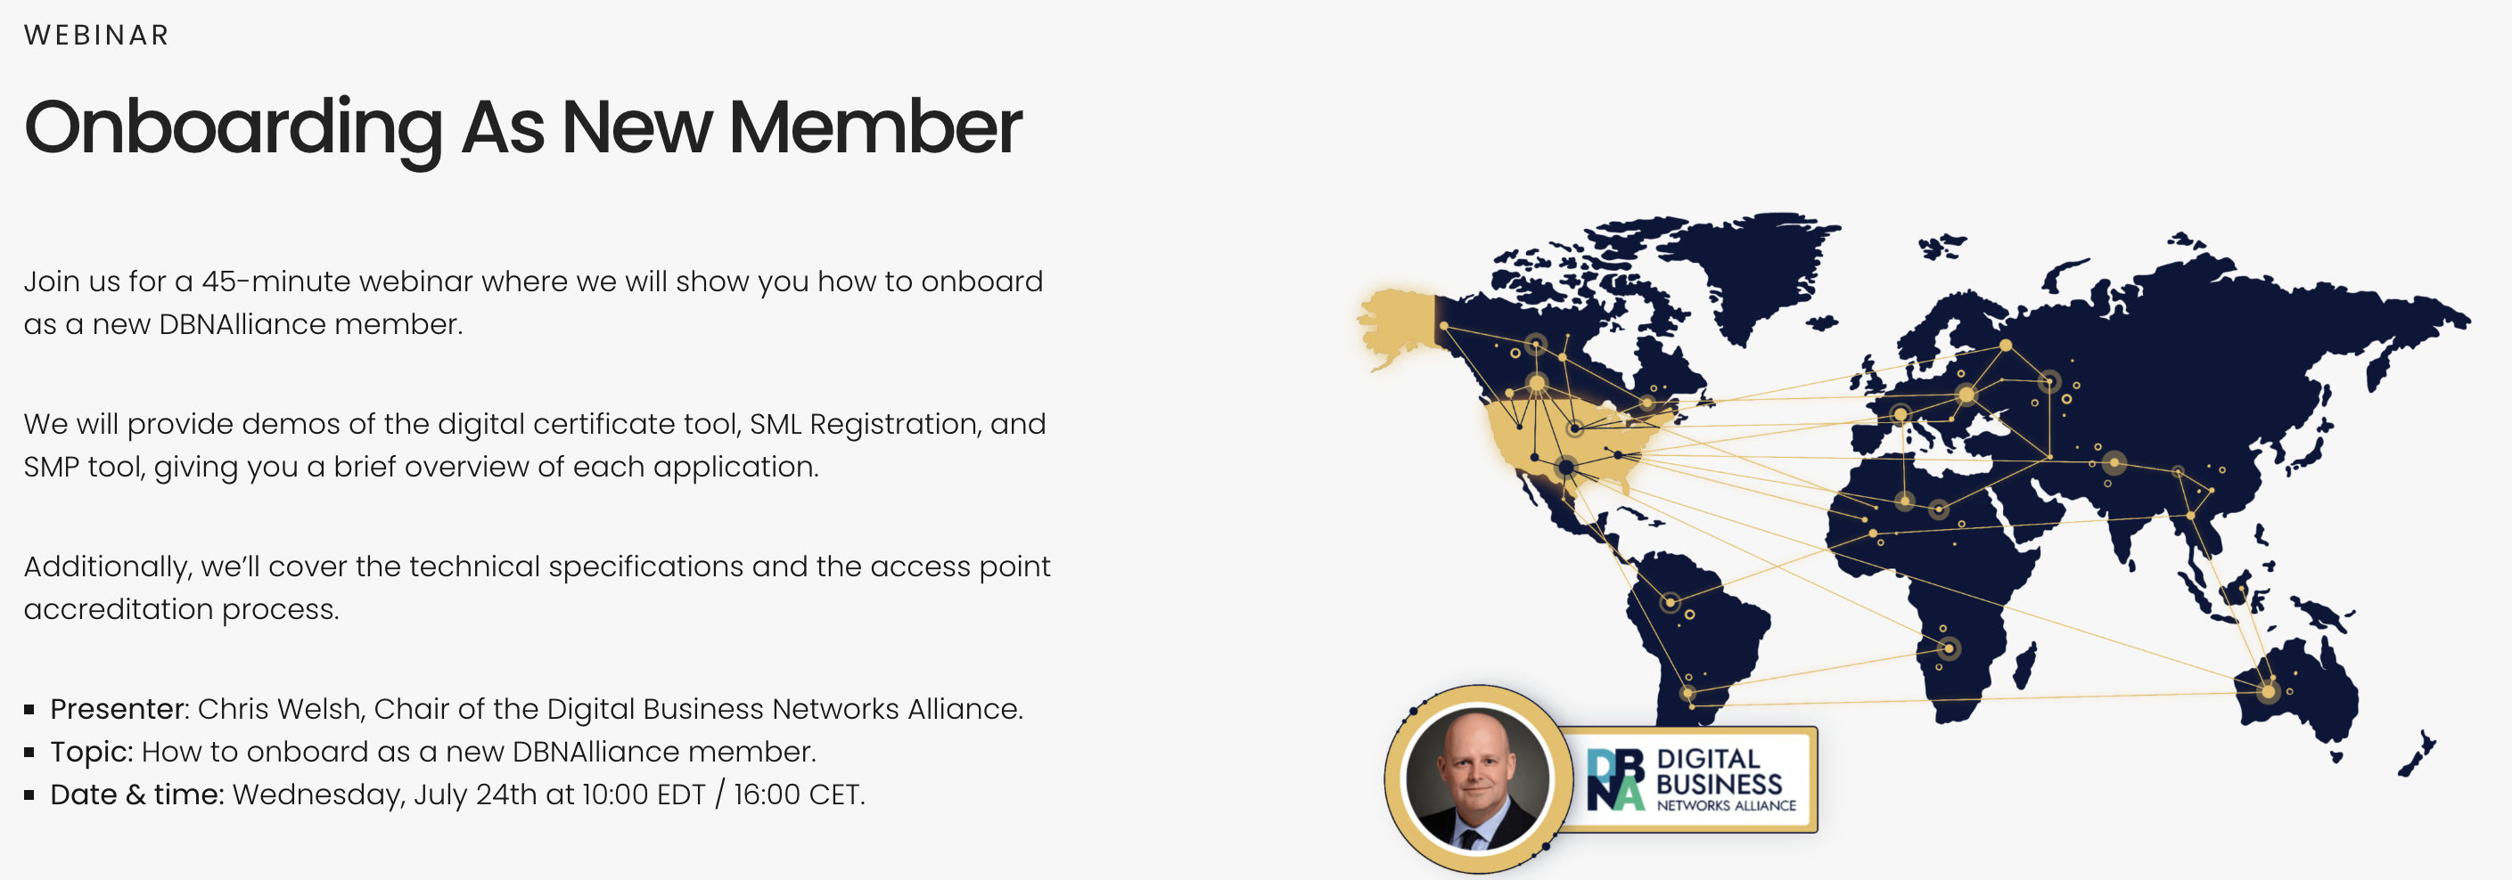
Notes:
2
5/8-9/2012

Slide 3

MISSION
To establish and operate an electronic delivery exchange network for all commercial enterprises in North America (starting with the United States).
The network supports the digital delivery of electronic business documents in a manner that allows customers of all Access Points to communicate with each other.

Slide 4
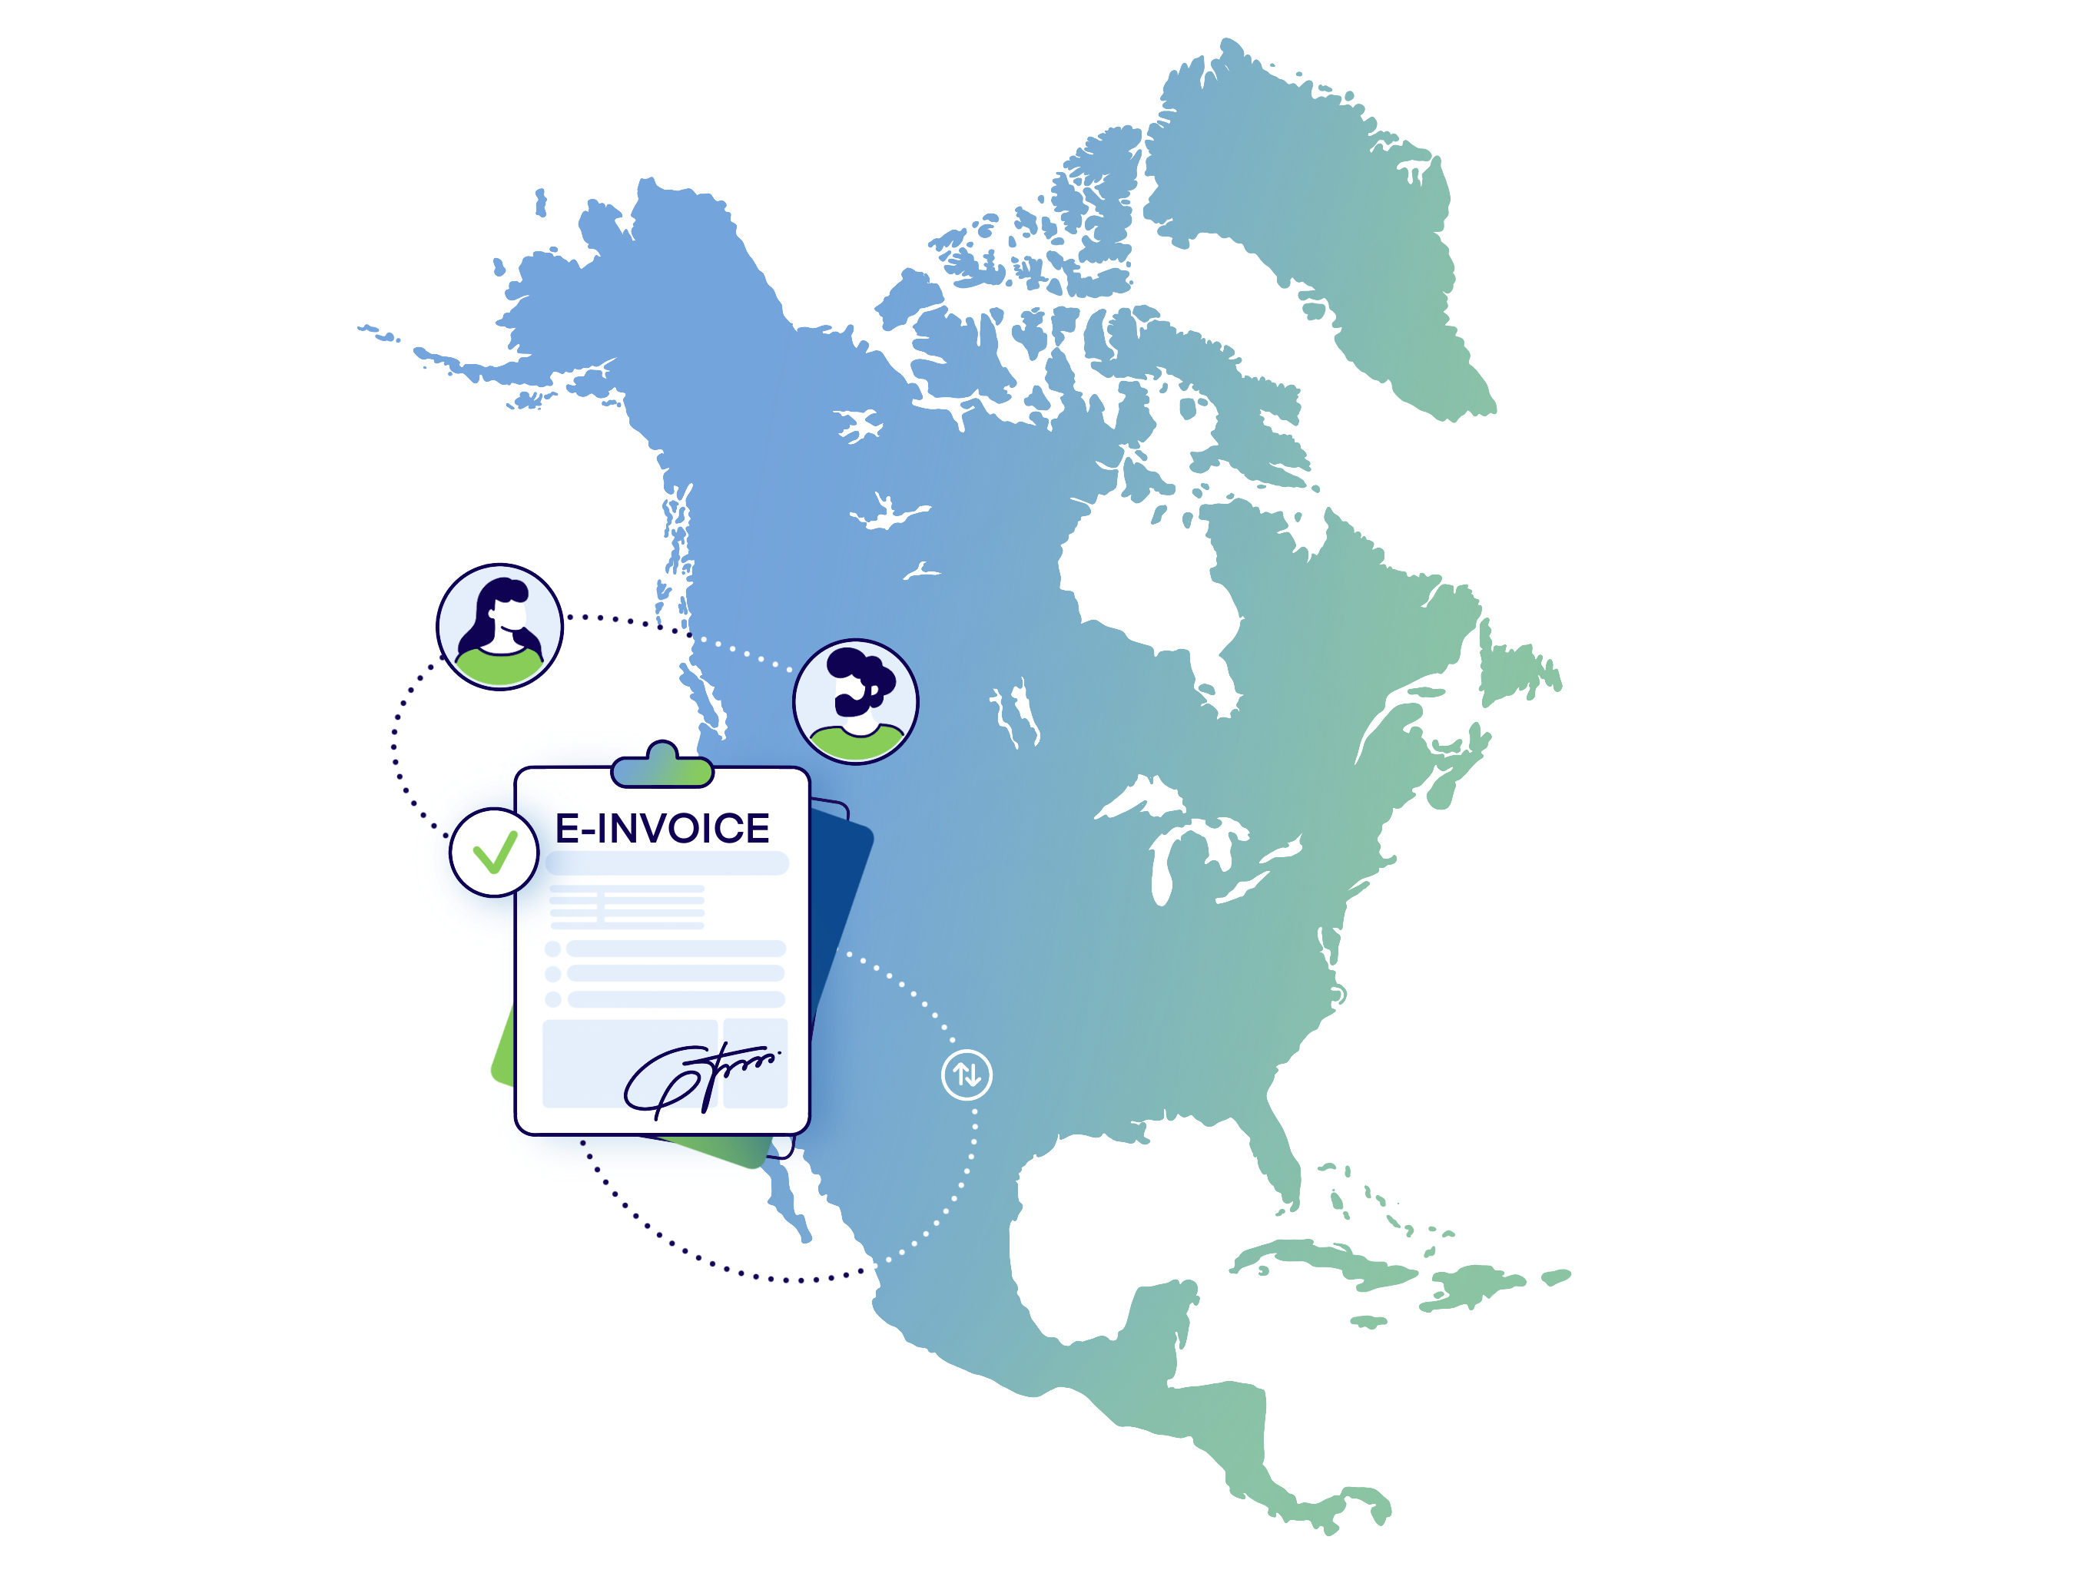
The Digital Business Networks Alliance
An independent, not-for-profit company (board is elected by its members);
~50/50 representation of Service Providers and Customers;
Supports faster payments across North America;
Industry lead, no involvement of public authorities;
Growth is organic and will bring access to new markets.

Slide 5
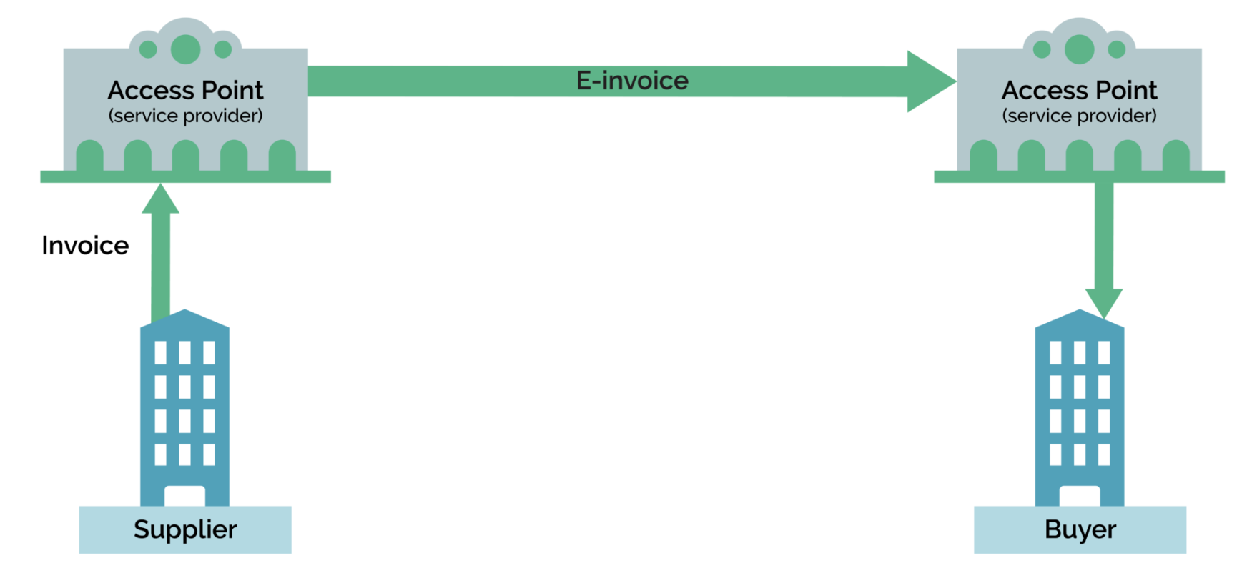
The Exchange Framework
The Exchange Framework was developed to solve the difficult issue businesses face when trying to connect with one another. Through a set of standards and policies, the Exchange Framework allows businesses to connect once, and share electronic invoices with one another, regardless of the platform, system, application or network they use for processing invoices.

Slide 6
Current Members (and growing quickly)
Service Providers
Avalara
Basware
Benefit
Billit
Crediflow
Digital Technologies Societa
DocStudio
Dooap Inc
eConnect International
Edicom
Service Providers
Facto
Finvix Technologies
Global Value Web
KOFAX Inc
MarineNet
Marosa VAT
Pagero
Peppolsoft
Photon Commerce
Quadient
Qvalia
Service Providers
RTCSuite
SAP
SNI Teknoloji
Sovos
Storecove
Taxera
TIE Kinetix
Unimaze
Customers
Chevron
ConocoPhillips
Halliburton
Microsoft
University Bank
Others . . .
Other Members
Digital Financial
OFS Portal

Slide 7
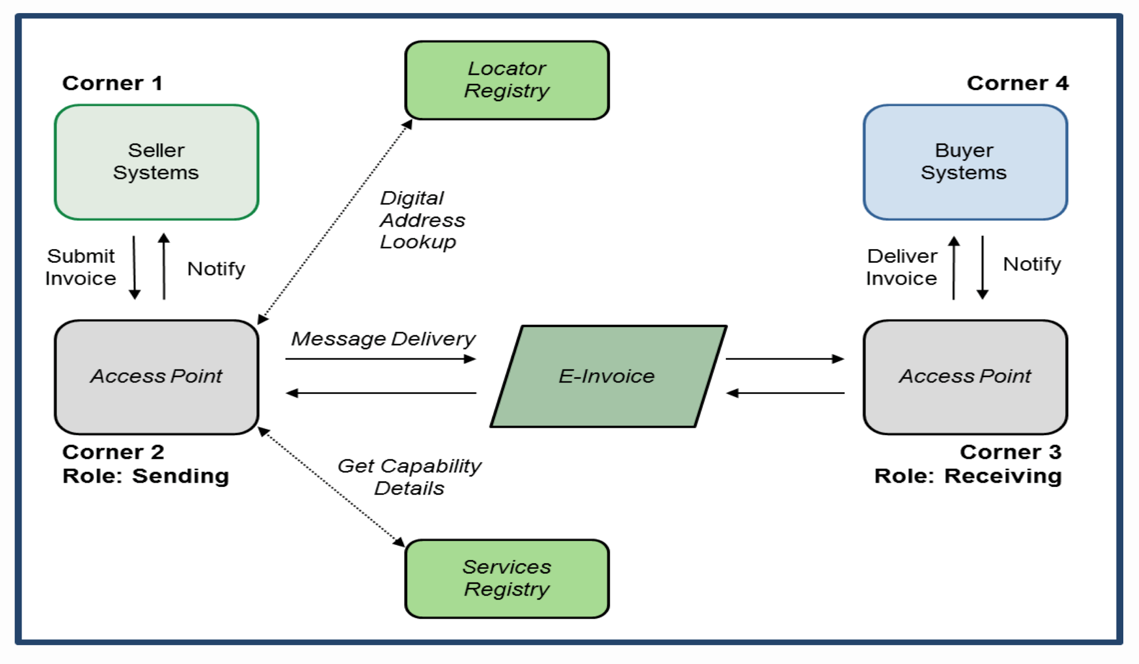
The Exchange Framework

Slide 8
The Exchange Framework
SML
AS4
UBL
SMP

Slide 9
Member Processes
Notes:
9
5/8-9/2012

Slide 10
New Member Onboarding Steps
1. SML Registrations – Access Point and Customers
2. Certificate Issuance – Access Points
3. SMP Registration Services – Customers
4. Committees and Workgroups – Technical and Marketing & Membership
5. Member Website & GITHUB – Up to date Information
6. Access Point Accreditation – Access Points
SET-UP STEPS
TRANSACTIONAL

Slide 11
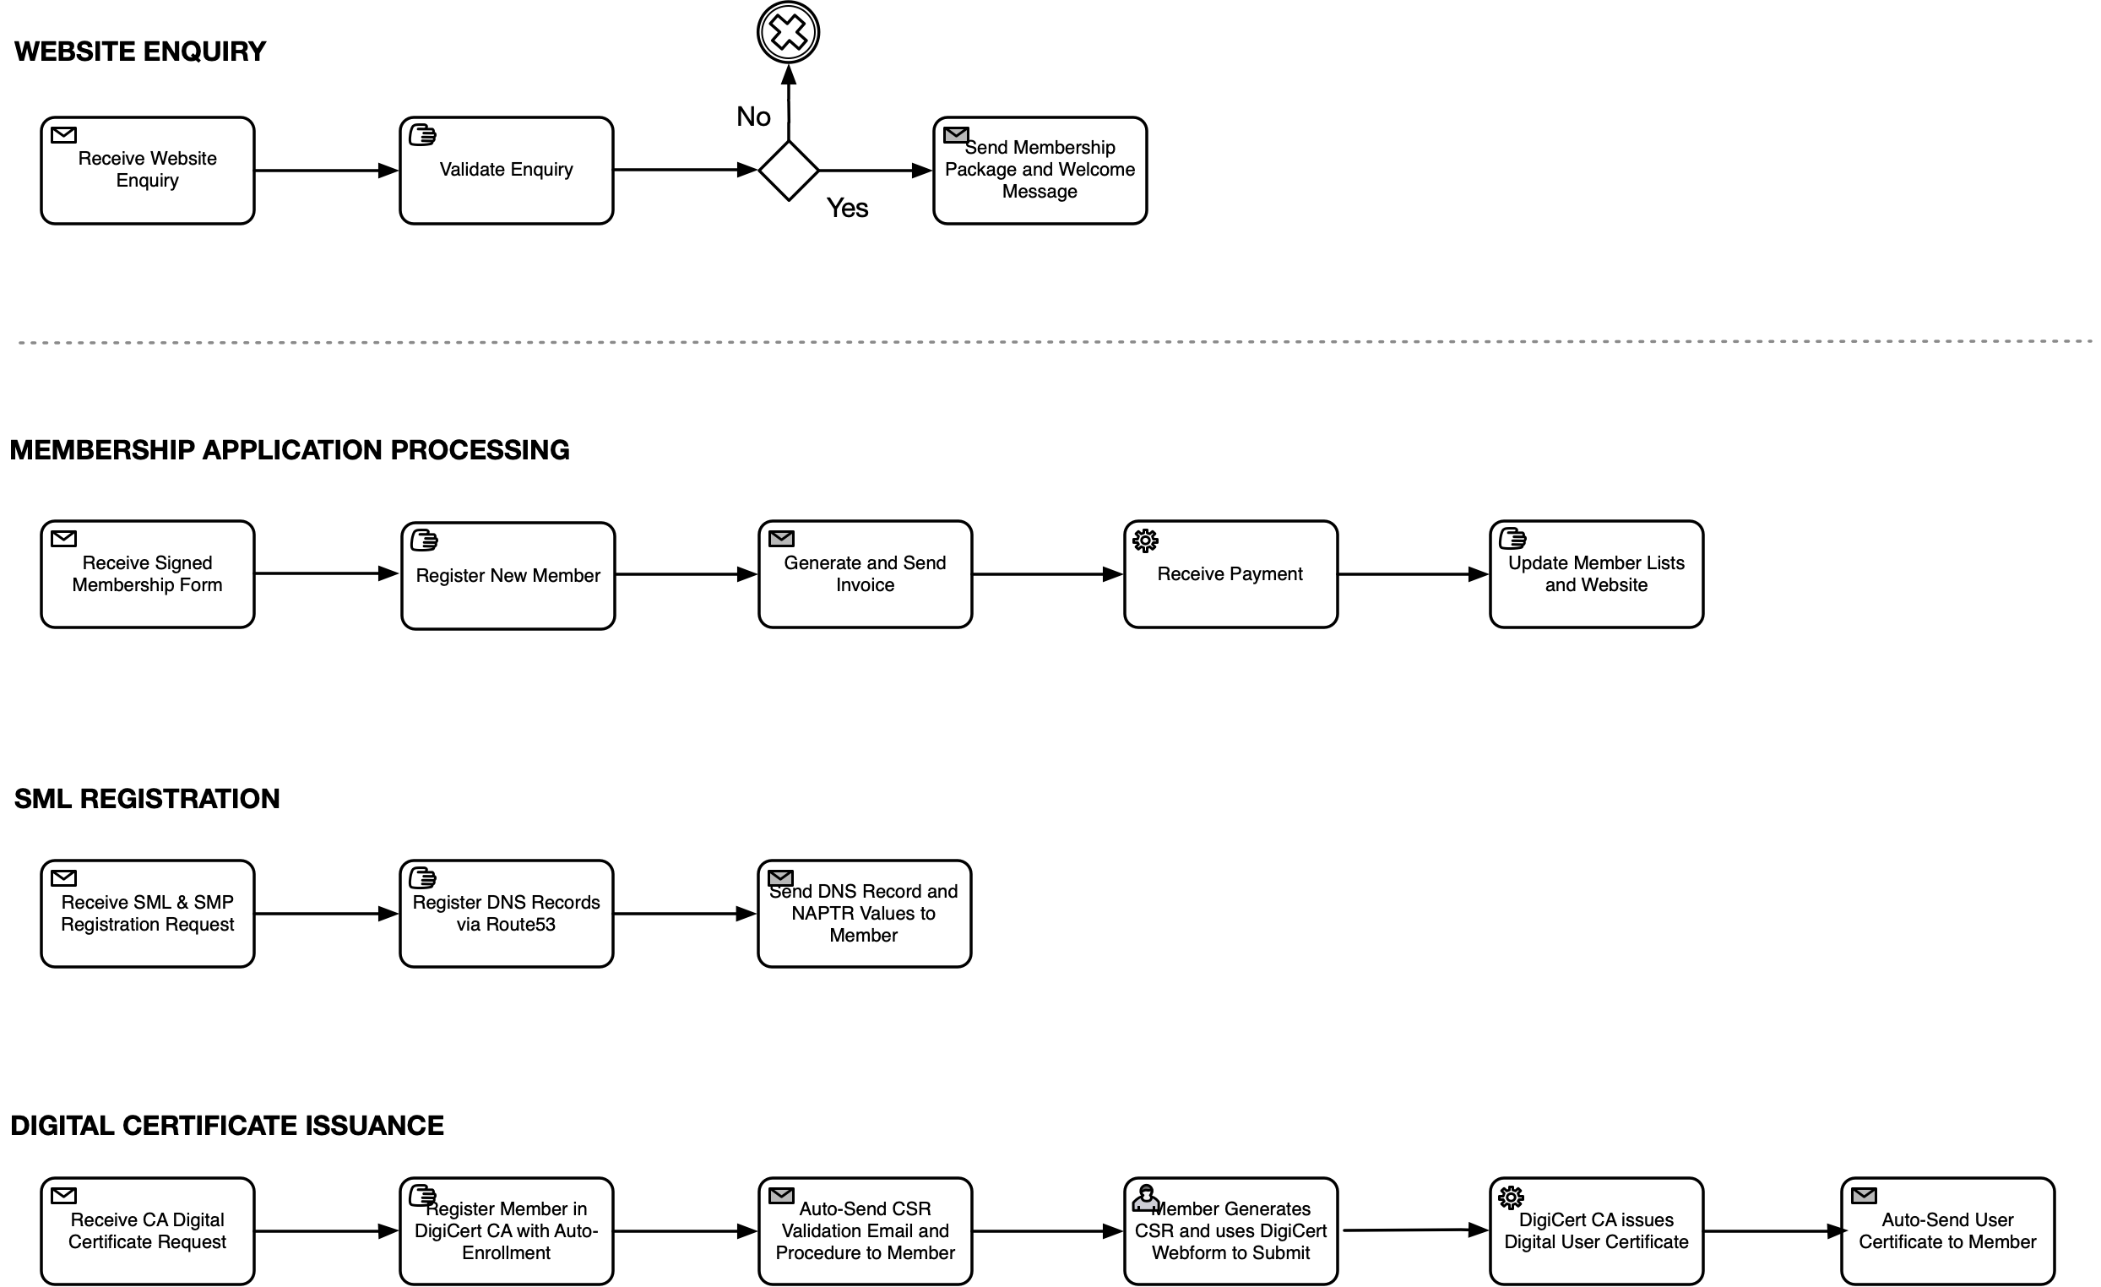
Sign Up and Set Up – Shared Services Roles
NON-MEMBER
FULL MEMBER

Slide 12
SML Registrations
Notes:
12
5/8-9/2012

Slide 13
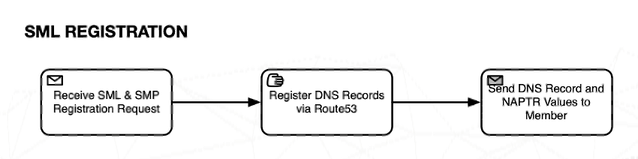
Understanding the three SML Domains Supported
The DBNAlliance has established three SML DOMAINS
to provided services to its members
PRODUCTION sml.dbnalliance.net
This is the production SML for the Exchange Framework. It is where Access Points will exchange commercial transactions for goods and services on behalf of their customers. Organizations must be members of the DBNAlliance to use this SML
TEST sml.dbnalliance.com
This is the test SML for the DBNAlliance Exchange Framework, organizations must be members of the DBNAlliance to use this SML. The TEST domain will be used to develop Access Points and test the extension of new document types to be supported prior to supporting them in the PRODUCTION domain.
PILOT sml.dbnalliancepilot.net
This is a PILOT SML Domain, currently used by the BPC eRemittance Workgroup, organizations do not need to be members to use this SML but they do need to be part of an existing pilot workgroup.

Slide 14
SML Registration Process
Send email to registrar@dbnalliance.org with the following details:
1. SCHEME of partner identifiers (such as DUNS or US:EIN)
2. PARTNER IDENTIFIER within Scheme
3. DOMAIN for the SML registration (PRODUCTION, TEST or PILOT)
4. SMP URL of the SMP service that handles requests for the PARTNER IDENTIFIER (such as smp.dbnalliance.org/test)
The registrar will set up the SML records for the PARTNER IDENTIFIER and return them to the initial requesting email address.
SUPPORTED SCHEMES can be found in GITHUB
https://github.com/dbnalliance/published-documents/blob/main/CCI-schemes-V1.2.1.xlsx

Slide 15
SML Registration Process – TOOLS
OFS Portal TEST Domain Records – SML.DBNALLIANCE.COM
Trading Partner ID - DUNS::028916588
SML Key - 5yuzjlyakkmvpfcwhh3guo62eivbbcpjoilxm7fvaxfigkqhydxq.sml.dbnalliance.com
SMP Returned from DNS Lookup - https://dbnasmp.kqa2.edicomgroup.com/
% bash get-smp-from-sml.sh 5yuzjlyakkmvpfcwhh3guo62eivbbcpjoilxm7fvaxfigkqhydxq.sml.dbnalliance.com
https://dbnasmp.kqa2.edicomgroup.com/

Slide 16
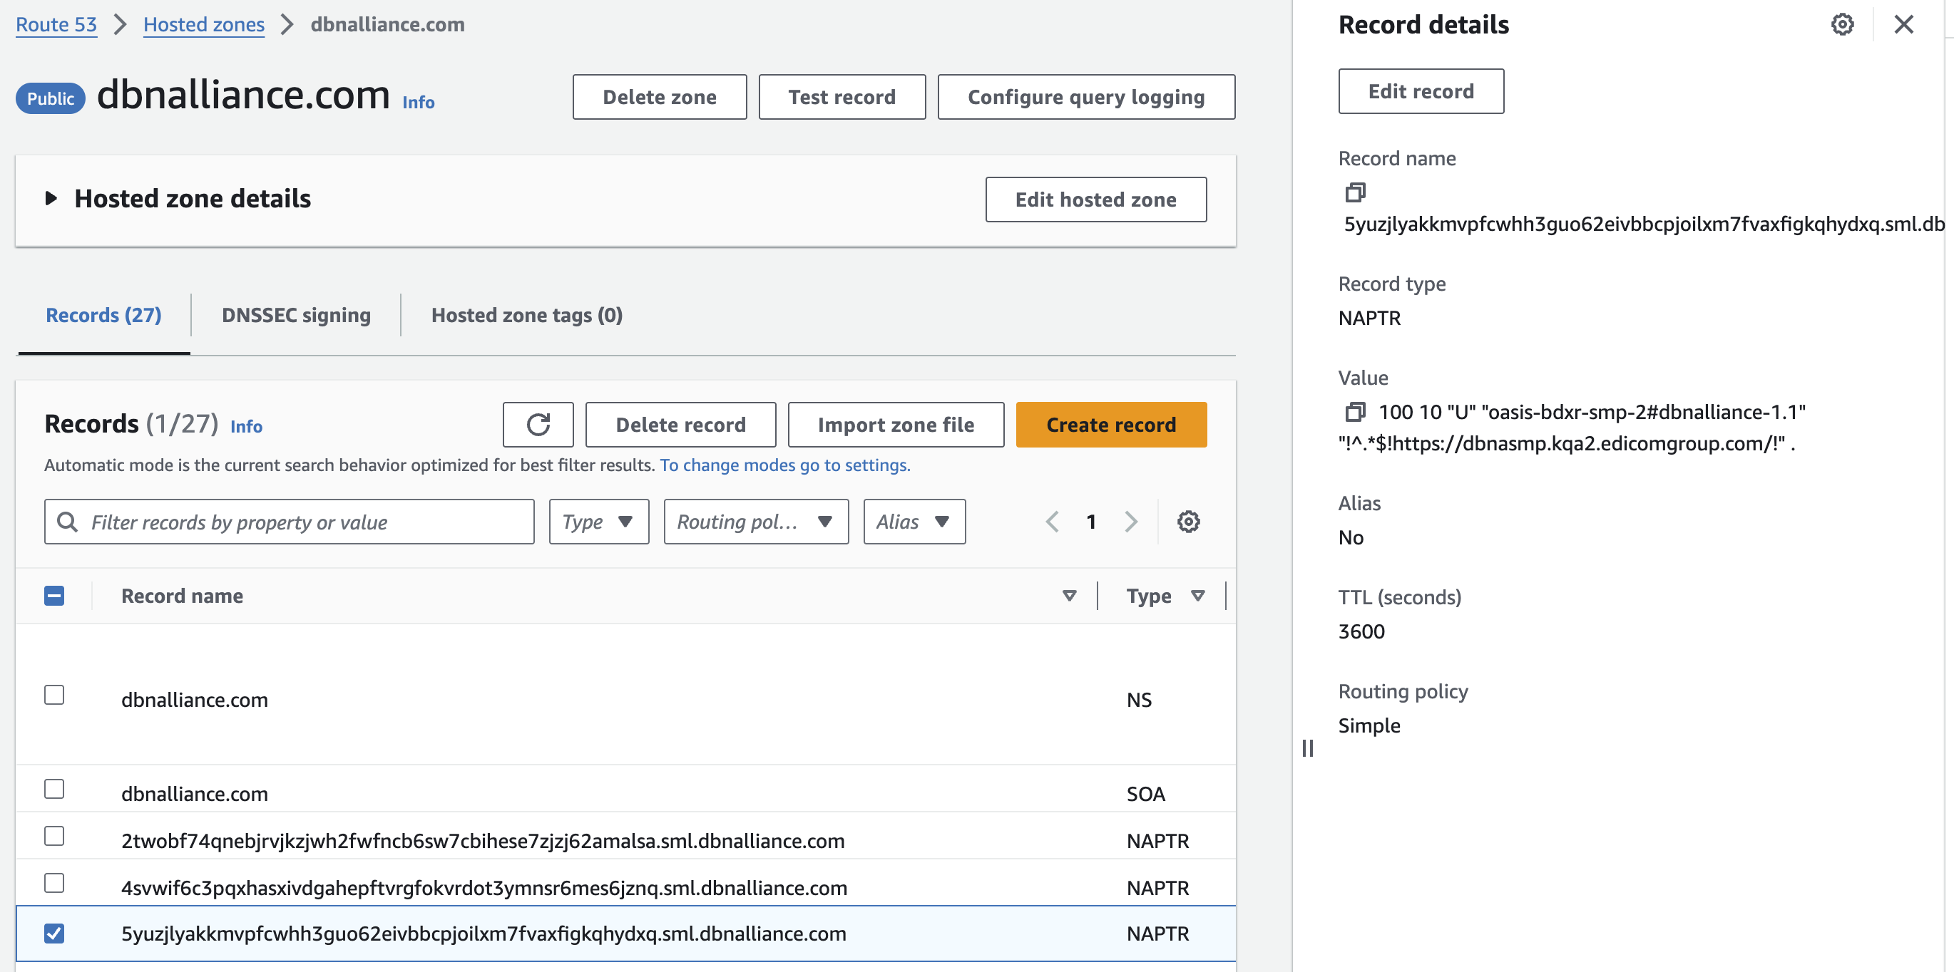
SML Registration Process – TOOLS

Slide 17
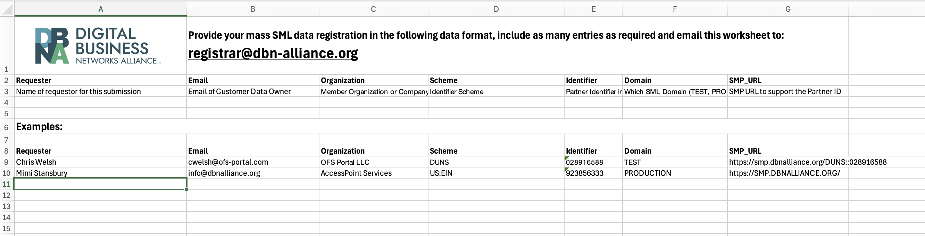
SML Registration Process – TOOLS
Mass Upload Capability by the registrar@dbn-alliance.org using this worksheet or CSV format
DBNAlliance_SML_DataRequirements.xlsx

Slide 18
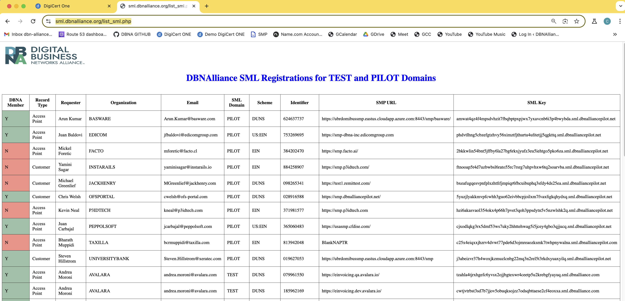
SML Registration Process – TOOLS
To View Test Partners use https://sml.dbnalliance.org/list_sml.php

Slide 19
Certificate Issuance
Notes:
19
5/8-9/2012

Slide 20
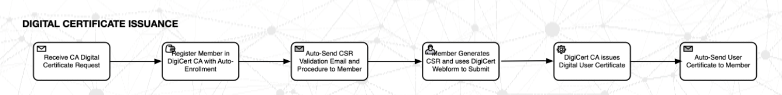
Digital Certificate Issuance
Send email to registrar@dbnalliance.org with the following details requesting a digital certificate:
1. Member Name of the Organization requiring the certificate
2. Technical Contact EMAIL and PHONE at the Member Organization to Receive the Certificate
3. DOMAIN for the SML to be used and certificate to be issued (PRODUCTION, TEST or PILOT)
The registrar will set up the DOMAIN specific certificate registration and send a CSR request and procedure document to the technical contact to get the certificate process started. The email will be sent from DigiCert which is the software used by the DBNAlliance to manage certificate issuance.
Follow the steps in the CSR procedure document to receive the certificate automatically.

Slide 21
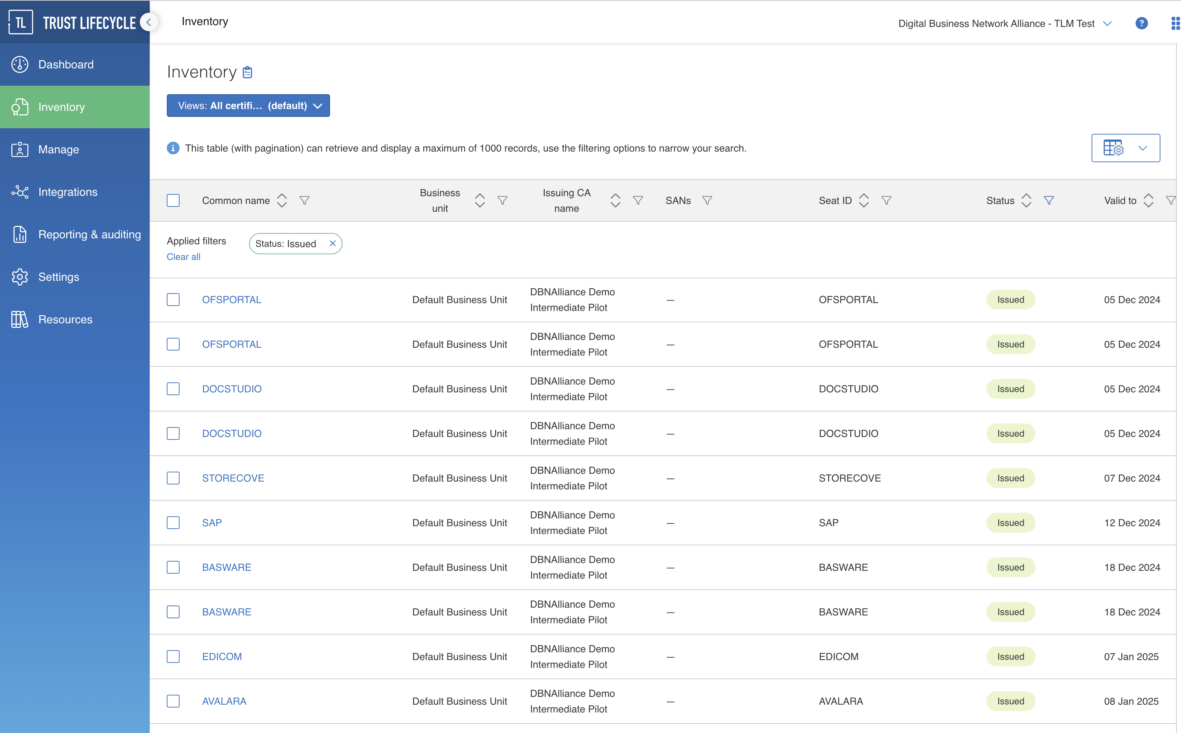
Digital Certificate Issuance
Automated Process Once the Member Organization is Registered

Slide 22
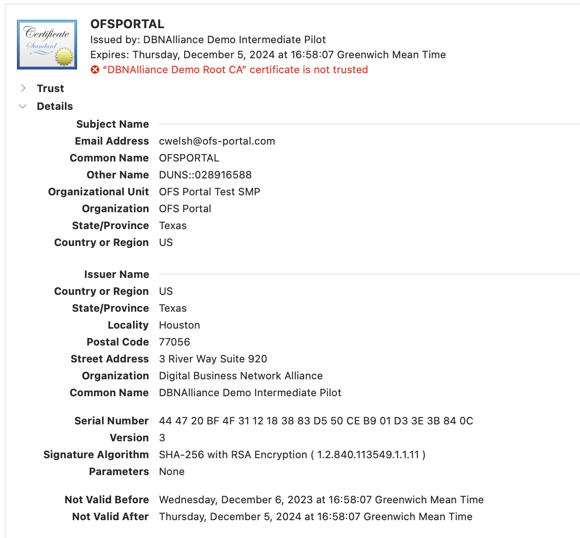
Digital Certificate Issuance
DBNAlliance is a Certificate Authority and Issues the Root, Intermediate and User Certificates.
Access Points are required to use Certificates for Encryption of Payload and Authenticity of Connection in the AS4 Transport.
The SMP holds the certificates for the Access Points and the SMP is used to “PULL” the Access Points USER certificate in real-time.

Slide 23
SMP Registration Services
Notes:
23
5/8-9/2012

Slide 24
SMP Registration Services
SMP Services are be available from the DBNAlliance for all three SML Domains
TEST – SMP.DBNALLIANCE.COM
PILOT – SMP.DBNALLIANCEPILOT.NET
PRODUCTION – SMP.DBNALLIANCE.NET
SMP Services will be structured in three tiers:
DEFAULT MULTI-TENANT – run by shared services and charged to members
WHITE LABELLED – SMP Service provided by shared services but member’s own domain name
MEMBER PROVIDED – SMP Service wholly provided by member, no DBNAlliance involvement

Slide 25
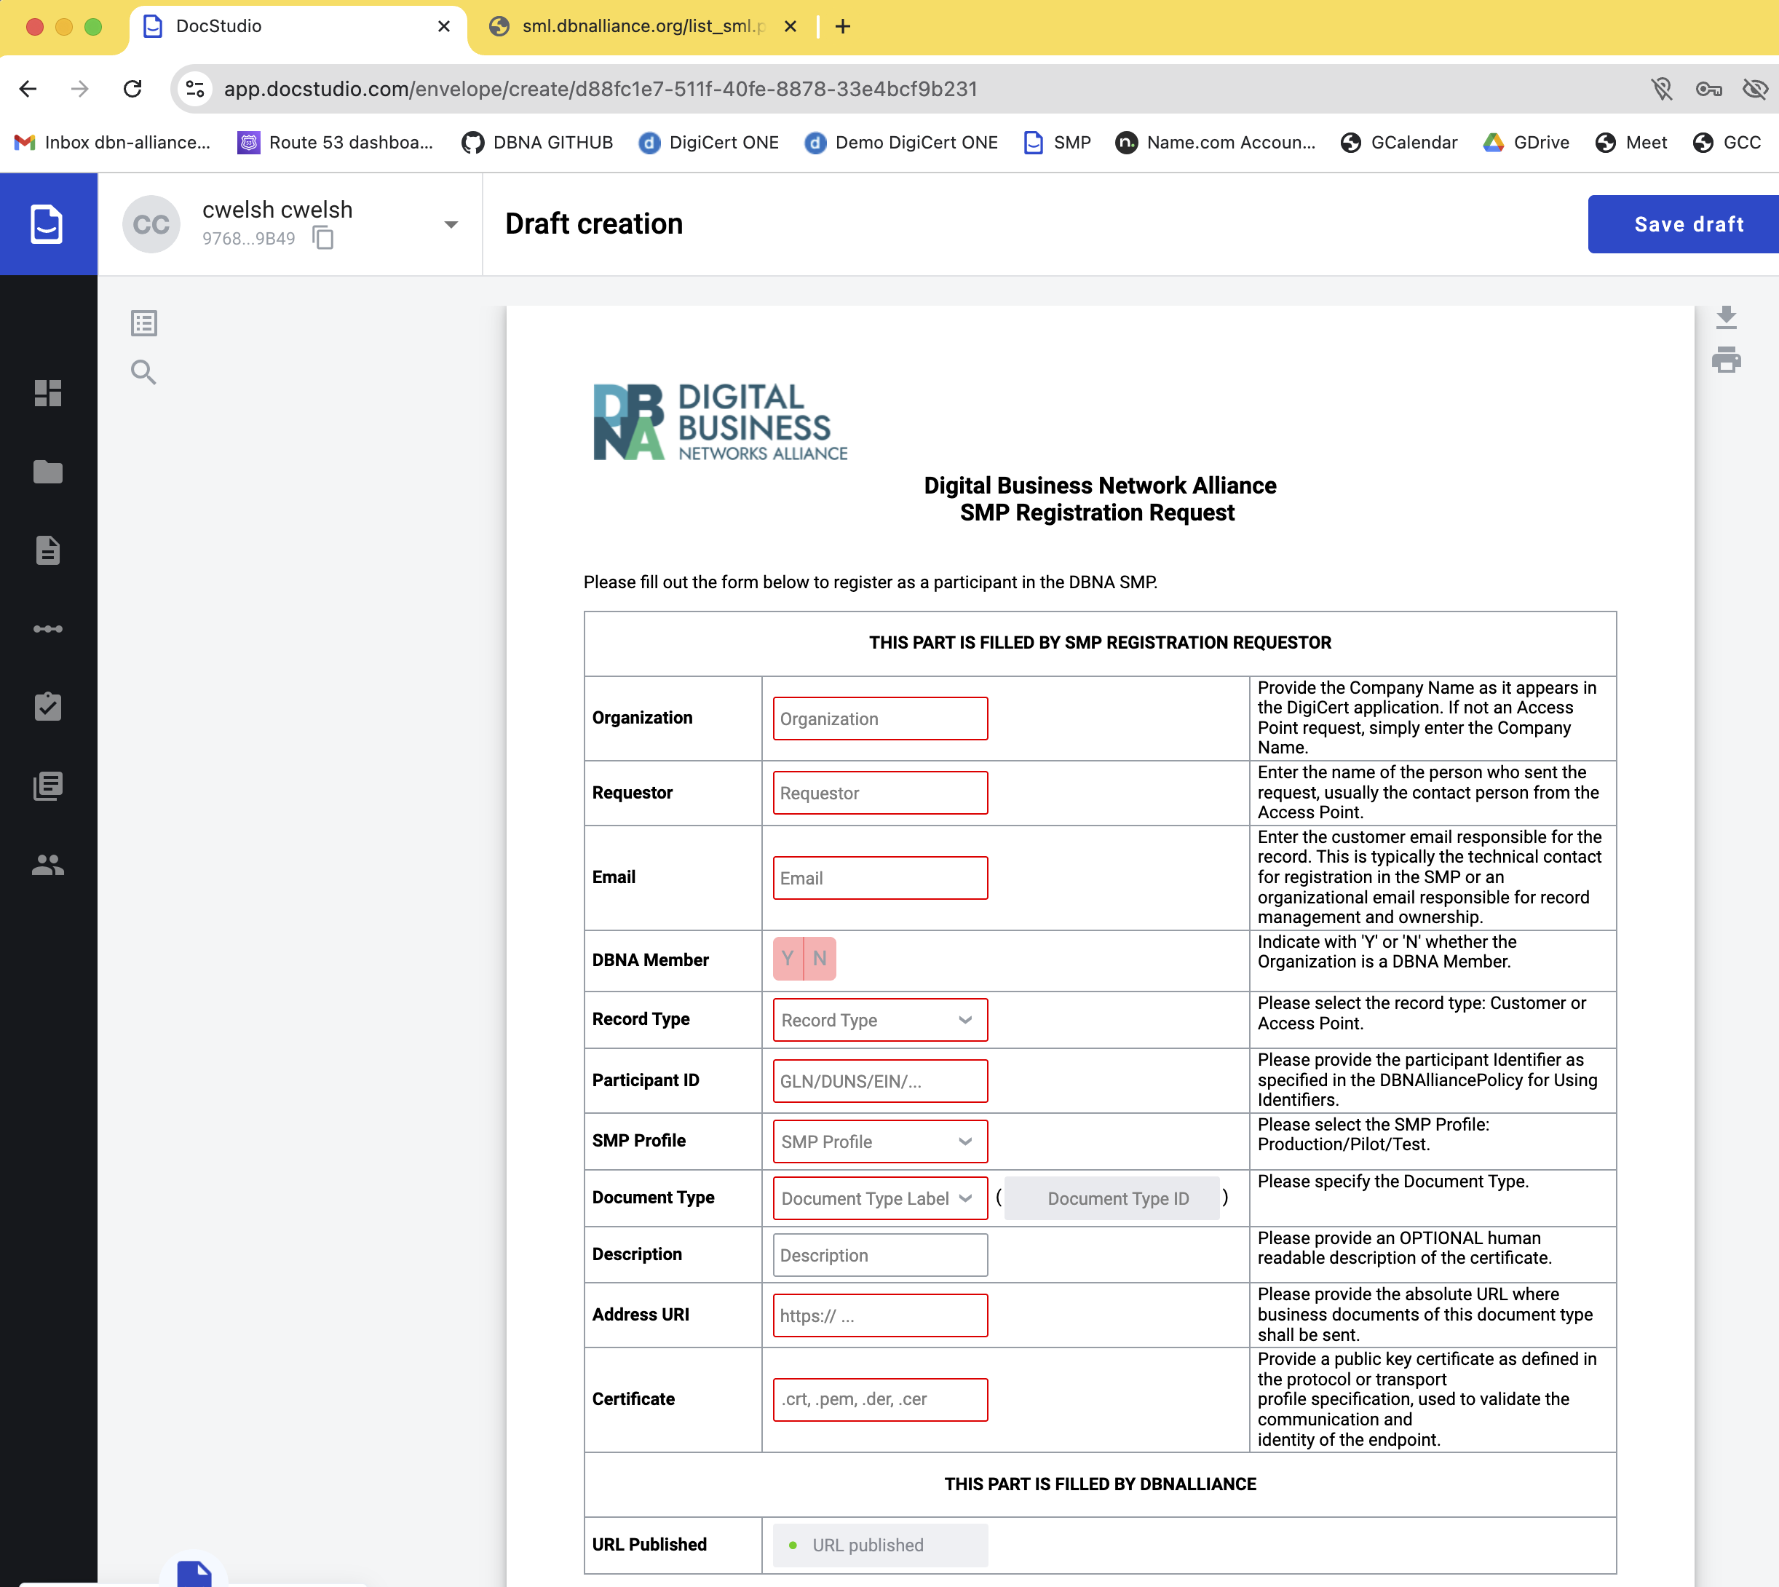
SMP Registration Services
Forms driven SMP registration services have been developed for those Access Points that do not provide their own SMP Services.
These services are processed by the Shared Services Team.

Slide 26
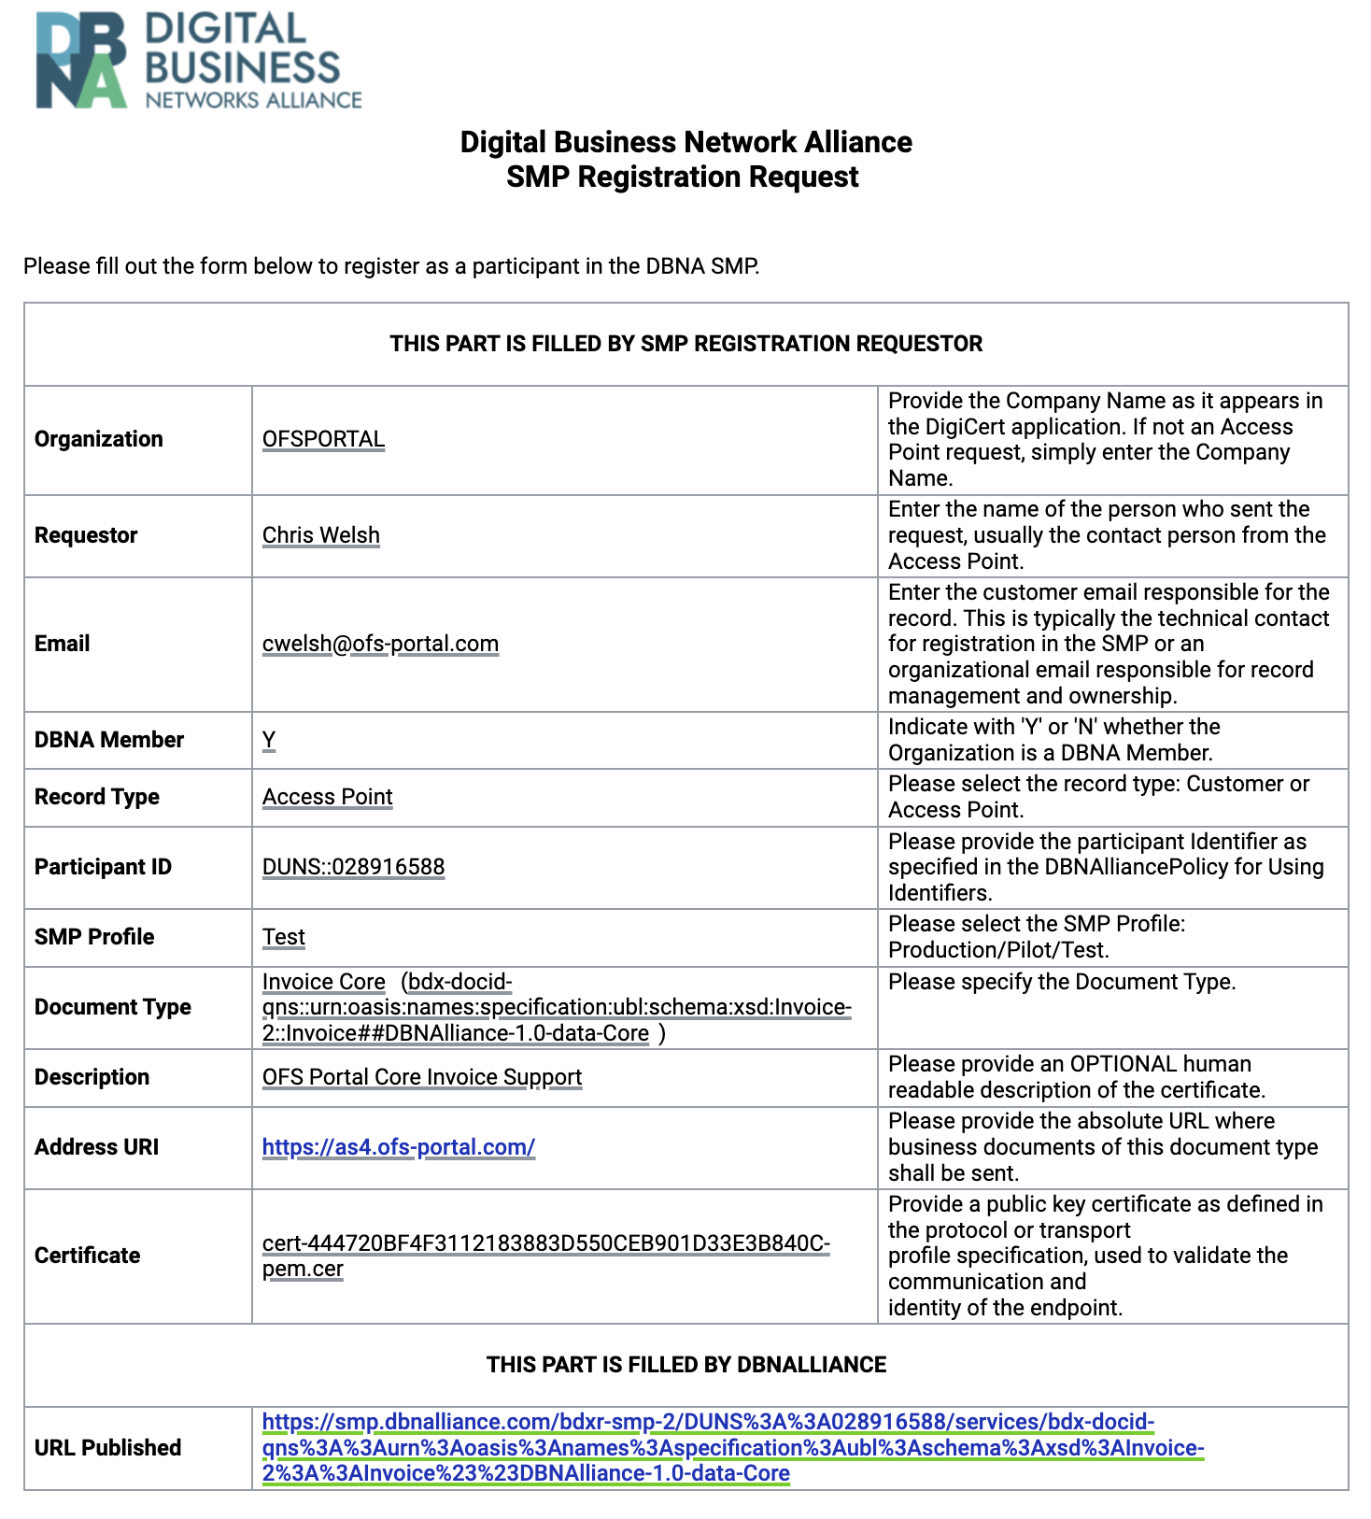
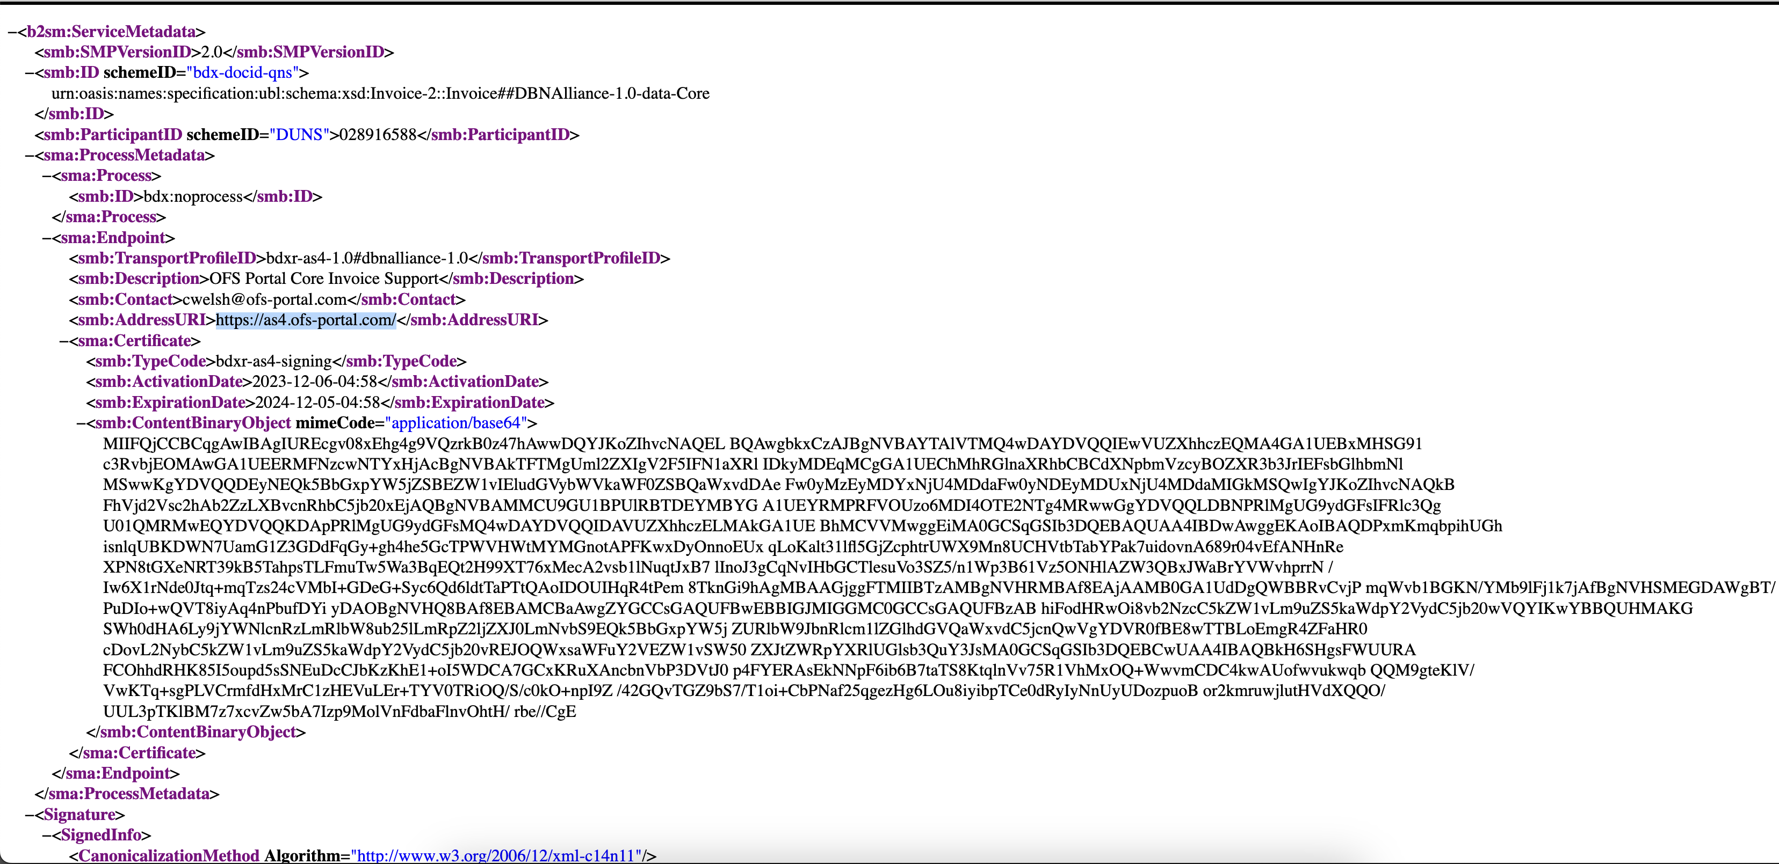
SMP Registration Services
Each supported document type can be registered.
The DBNAlliance issued certificate is loaded correctly.
The address for the AS4 server is registered per document type.

Slide 27
Member Website & GITHUB
Notes:
27
5/8-9/2012

Slide 28
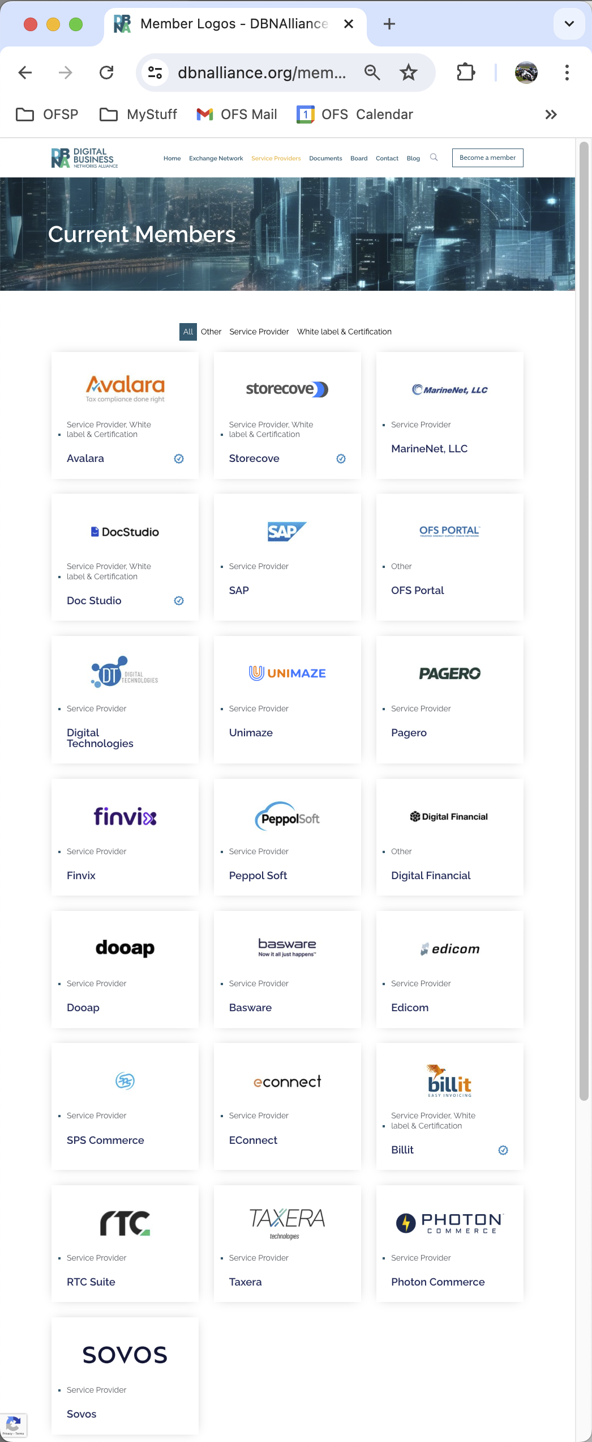
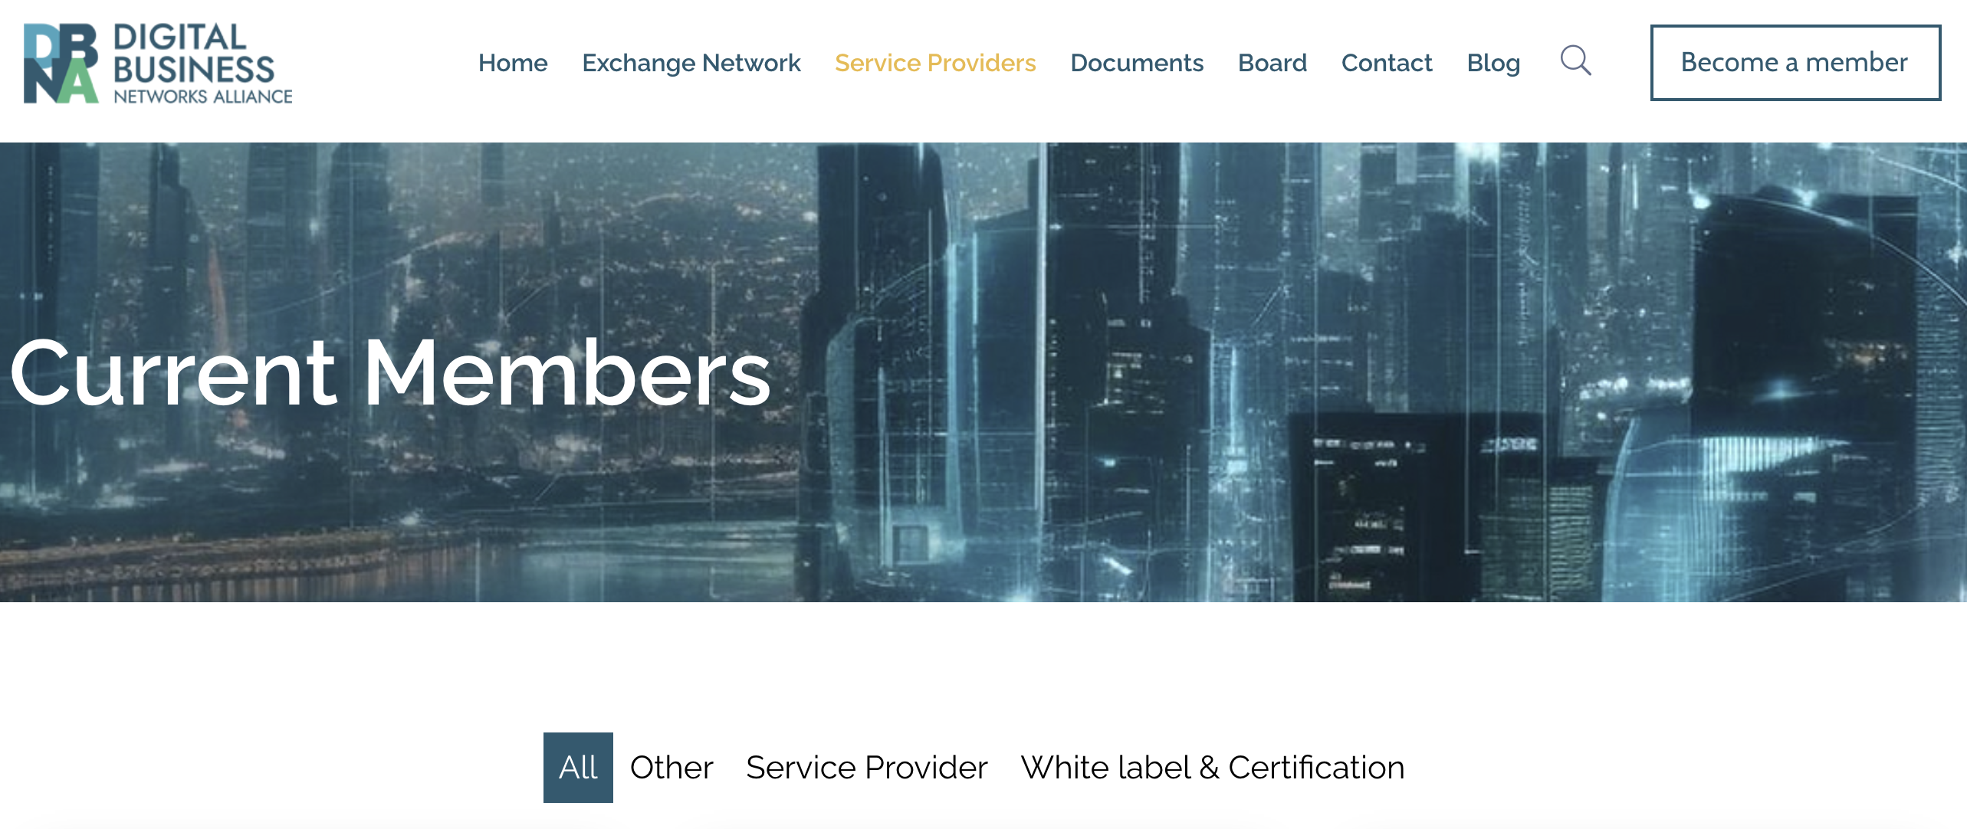
Member List on Website
Members can promote their services on the members website.
Access Point Accreditation will be recorded here.
https://dbnalliance.org/member-logos/

Slide 29
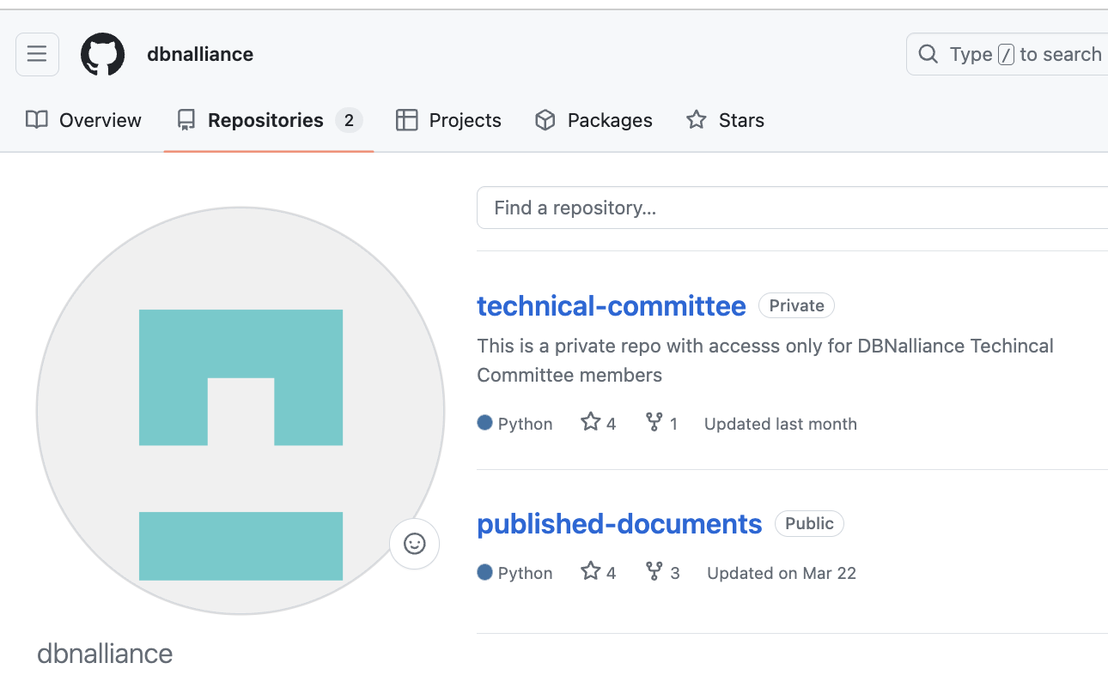
GITHUB Technical Specifications
The DBNAlliance supports two repositories for technical specifications:
published-documents – this is open to anyone and contains the latest technical specifications published by the DBNAlliance regarding the configuration and use of the Exchange Framework.
technical-committee – this is a members only repository and contains all the published works as well as all the new technical specifications under development.
To have access to the technical-committee repository, your organization must be a member of the DBNAlliance. Send email to techcommittee@dbn-alliance.org requesting access to the PRIVATE github repository, the following details are required; Email addresses of the technical contacts in your organization that will participate in the technical committee and will need access to the development GITHUB repository.
https://github.com/dbnalliance/technical-committee
https://github.com/dbnalliance/published-documents

Slide 30
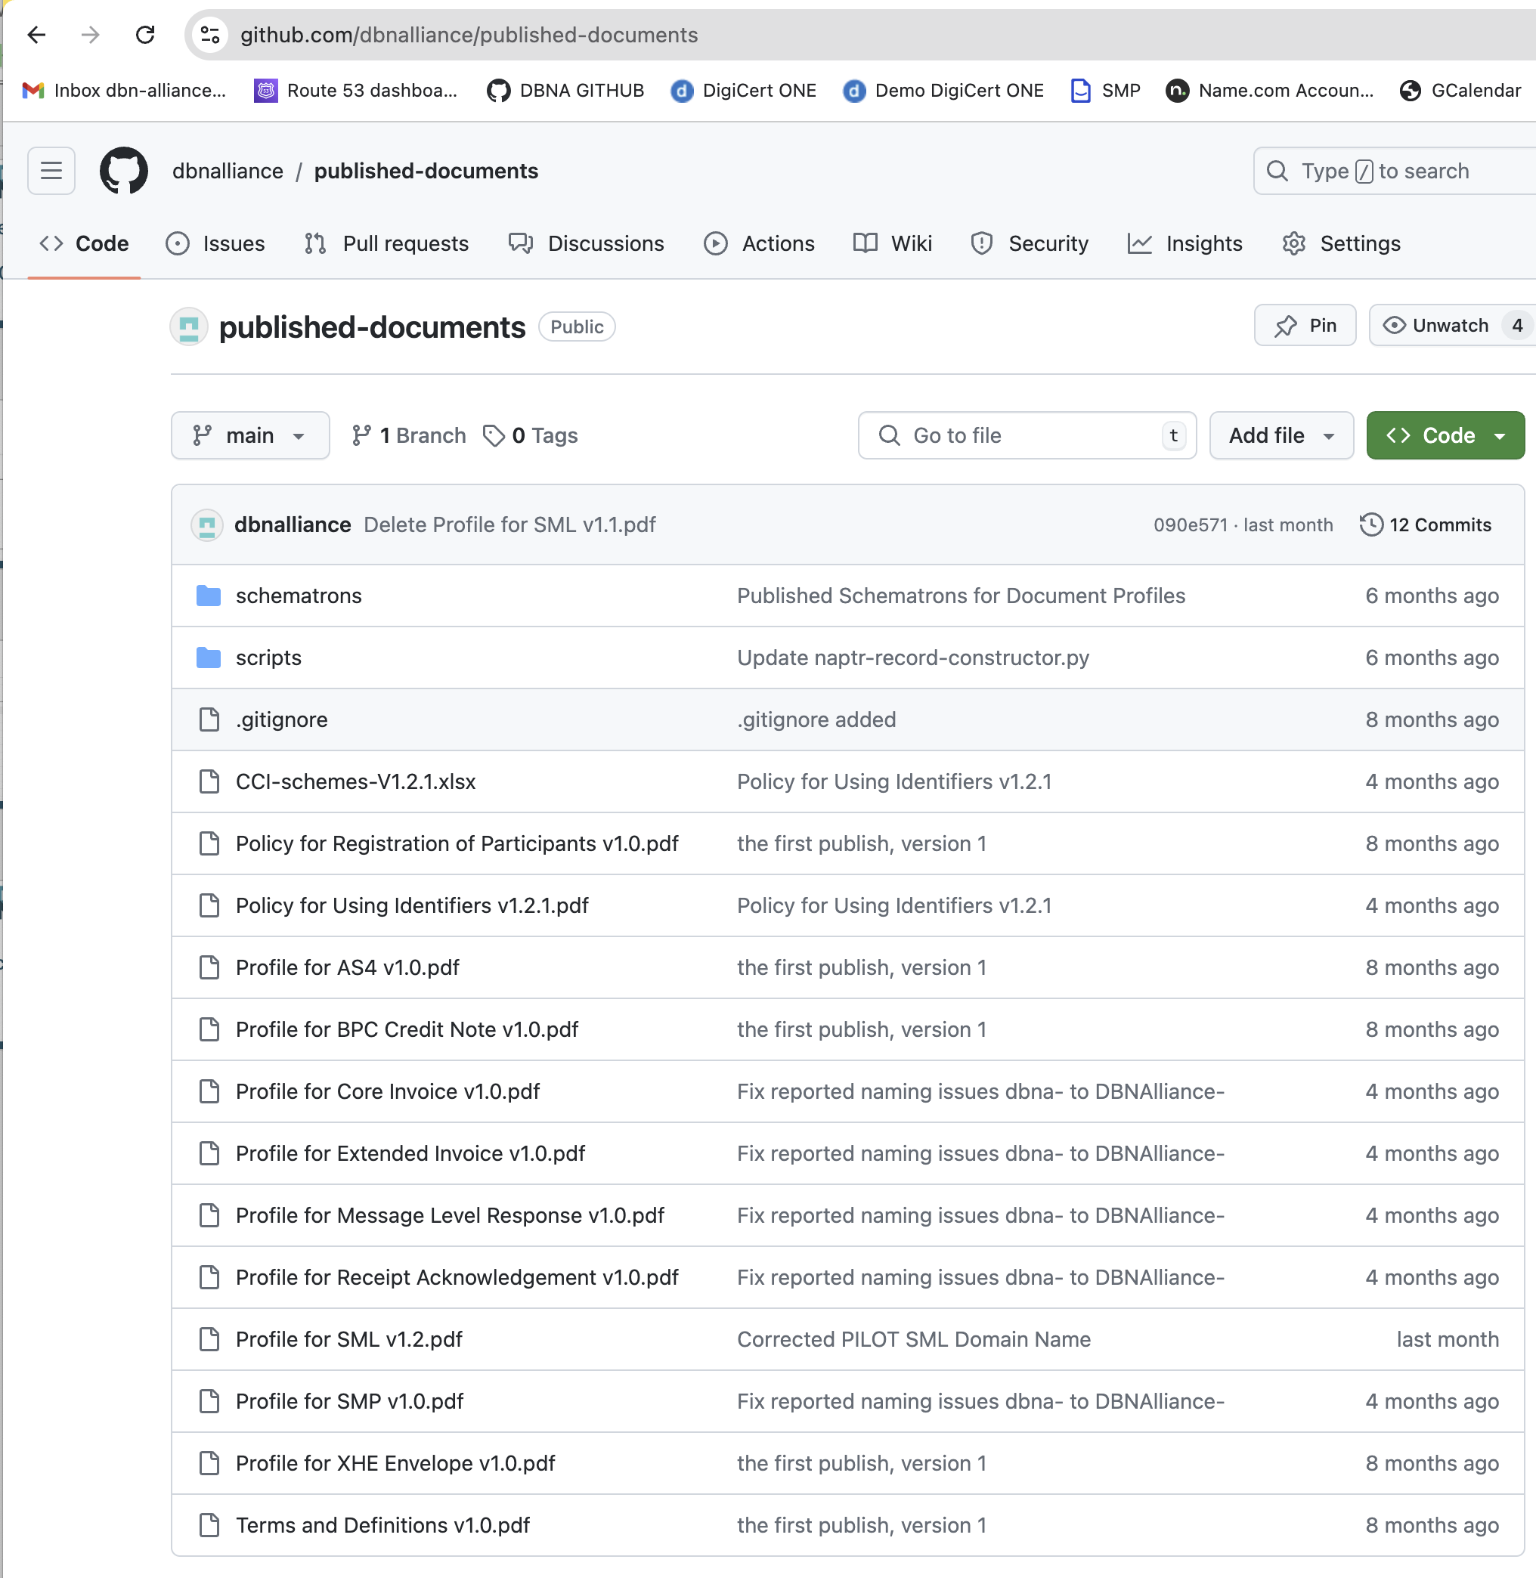
GITHUB Technical Specifications
The most up to date PUBLISHED specifications and profiles can be obtained at the public GITHUB site
https://github.com/dbnalliance/published-documents

Slide 31
Committees & Workgroups
Notes:
31
5/8-9/2012

Slide 32
Workgroup Membership
The DBNAlliance has established two member workgroups.
Technical Committee – Develops new specifications and maintains existing published standards and policies. The committee meets weekly to progress enhancements to the Exchange Framework proposed by its members.
Marketing Committee – Develops marketing materials and events and promotes the DBNAlliance Exchange Framework to industry. Meeting every two weeks the Marketing Committee is the external voice of the DBNAlliance to the market and eCommerce community.
Member Organizations interested in enhancing the network can elect their employees to join these committees by sending an email to the respective committee workgroup email requesting their employees email addresses to be added to the committee lists. Meeting schedules and notes will then be sent to these new members.
Marketing Committee – marketing@dbn-alliance.org
Technical Committee – techcommittee@dbn-alliance.org

Slide 33
Access Point Accreditation
Notes:
33
5/8-9/2012

Slide 34
Access Point Accreditation
The DBNAlliance has committed to establish an accreditation process for Access Points to check fundamental connectivity and inter-operability. Access Points will receive an accreditation certificate for the DBNAlliance on completion.

Slide 35
Member Processes Recap
Notes:
35
5/8-9/2012

Slide 36
New Member Onboarding (1 of 2)
SML Registrations
  For SML registrations of access point details or customers, please email the completed worksheet attached to registrar@dbn-alliance.org
Certificate Issuance
  For certificate issuance, please send an email to registrar@dbn-alliance.org requesting certificates for the domain required, there are three domains explained ion the attached slide deck, TEST, PRODUCTION and PILOT
SMP Registration Services
  If you are not providing your own SMP services as an Access Point, please let the registrar know at
  registrar@dbn-alliance.org and we can discuss DBNAlliance providing SMP services on your behalf for you and your customers?

Slide 37
New Member Onboarding (2 of 2)
Committees and Workgroups
  Please email the relevant Committee email to ask for your team members to be registered:
    Technical Committee - techcommittee@dbn-alliance.org
    Marketing and Membership Committee - marketing@dbn-alliance.org
Member Website & GITHUB
  Do we have your approved logo file to add to the members website, please can you send it to
  membership@dbn-alliance.org and it will be added to the website? If you provide whitelabeled services you can note this in your member entry on the website. Get access to the GITHUB Technical Repository, send the request to techcommittee@dbn-alliance.org
Access Point Accreditation
  Once your Access Point is developed, it will be able to test it’s operations are compatible with the rest of the Access Points on the Exchange Framework through the Access Point Accreditation process. The Shared Services team will guide the Access Point support staff through the process and issue the accreditation certificate at completion.

Slide 38
Members Meeting - Houston
Agenda for the face to face meeting in Houston Texas on the 19th September 2024
The evening before (18th) we will plan to hold an evening reception in Houston at a local restaurant, location to be confirmed, attendance is not mandatory but if Members are in Houston then they are invited to participate.
The format of the day is:
0900-1000 Member meeting to elect/re-elect the Board Members
1030-1130 Board Meeting to welcome new board members
1130-1230 Lunch
1230-1530 Combined Members Meeting - Technical and Marketing Committees to present
(open invitation to new potential members too)
1530 Adjourn

Slide 39
Questions?
https://dbnalliance.org
membership@dbn-alliance.org
Notes:
39
5/8-9/2012

